Slide 1
Asymmetric Effects of US Monetary Policy International Edition
Discussion:
Elia Di Gregorio & Marie Püts

Slide 2
Questions:
How did you transform your data? Is taking log enough to make data stationary?
In your threshold model, you did not find significant differences between the low and high growth periods. Does this mean that the spillover effects of US monetary policy are the same across the business cycle?
Can you explain, if any, the differences between the spillover effects of US monetary policy on developing countries vs developed countries using your model?

Slide 3
EU Core-Periphery Division in the wake of Deglobalization
Marie Püts and Elia Di Gregorio

Slide 4
Structure
Introduction
Literature review
Motivation
Dataset
Cluster Analysis – Methodology
Implication for EU Cohesion
A step further: Deglobilization
Conclusion

Slide 5
Introduction
Economic Complexity
Political Unity
Regional Diversity
European Union (EU)
Complex mosaic of interconnected economies
Well suited to be analyzed within framework of Core-Periphery Model

Slide 6
Introduction – Core Periphery Model
Endogenous differentiation into an industrialized core and an agricultural periphery
CORE
PERIPHERY
Economic Prosperity
High levels of industrialization
Well-developed infrastructure
Better access to essential resources
Economic Disadvantages
Limited industrialization
Underdeveloped infrastructure
Lower access to essential resources

Slide 7
Literature Review
The duality and diversity of EU is a topic thoroughly covered by several authors:
Caraveli (2016) examines the core-periphery division in the European Union within the context of global imbalances and geopolitical changes. Addresses the challenges to the economic and political dominance of the West and changes to the European core-periphery pattern.
Gräbner & Hafele (2020) investigate the emergence of polarization patterns in the EU over the last 60 years from a structuralist and complexity economics perspective.
Rauhut & Humer (2018) identify the current economic thought influencing the EU Cohesion Policy.
Kersan-Škabić (2019) investigates the heterogeneity of economic performances in EU member states contributing to the core-periphery relationship.

Slide 8
Motivation
Research Question: Investigate the Core-Periphery Model as it is applied to the European Union, updating the status of division.
Assess key elements future EU Cohesion Policy should consider
Contextualize results within larger Deglobalization trend

Slide 9
Dataset
World Bank
World Development Indicators
Worldwide Governance Indicators
Health and Population Statistics
Eurostat
Thematic groups:
Economic Performance
Governance and Institution
Research and Development
Labor and Employment
Population and Demographics

Slide 10
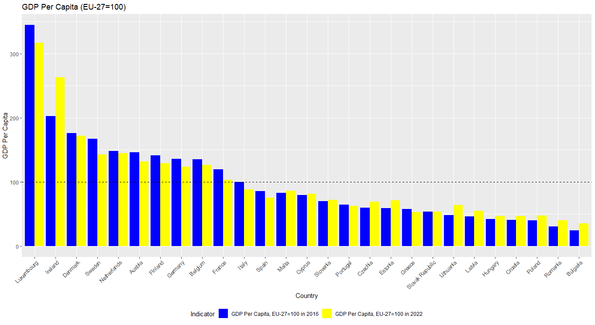
EU Winner and Losers
Clear divide North South-East Europe BUT dynamic centre of growth is shifting

Slide 11
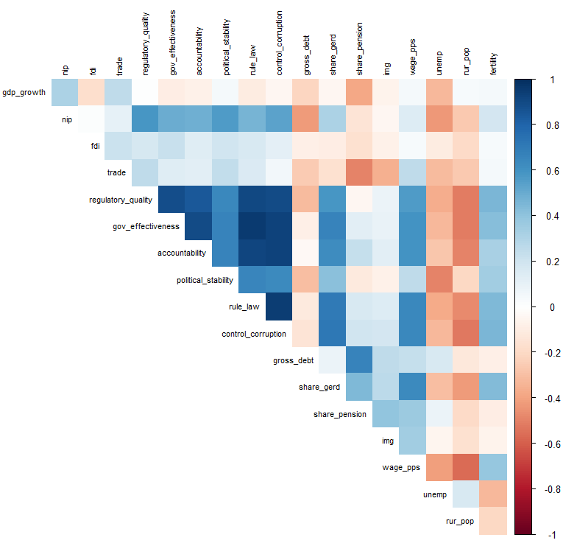
Cluster Analysis - Methodology
Variable screening and cleaning
Correlation threshold
Imputation NAs
Scaling
3 subsets:
EU - 2000
EU - 2011
EU - 2021
Number of cluster determined by majority rule

Slide 12
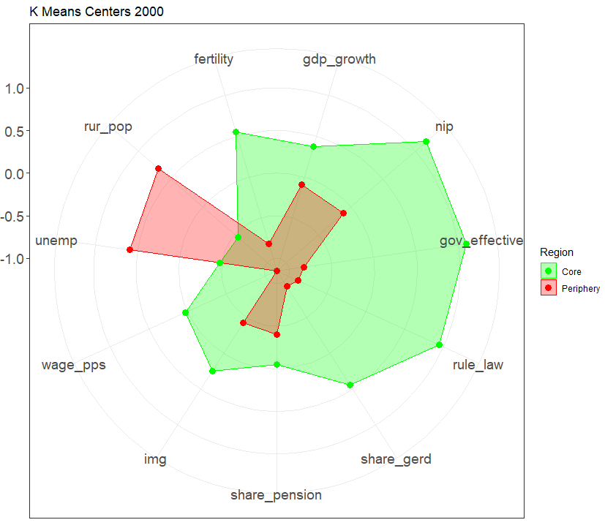
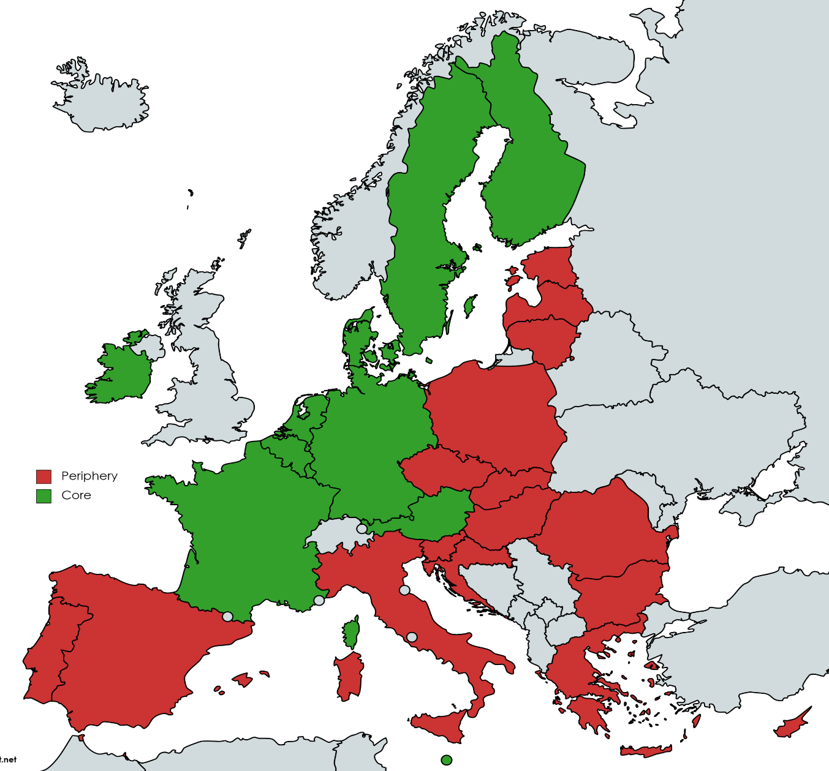
EU Core – Periphery in the 2000

Slide 13
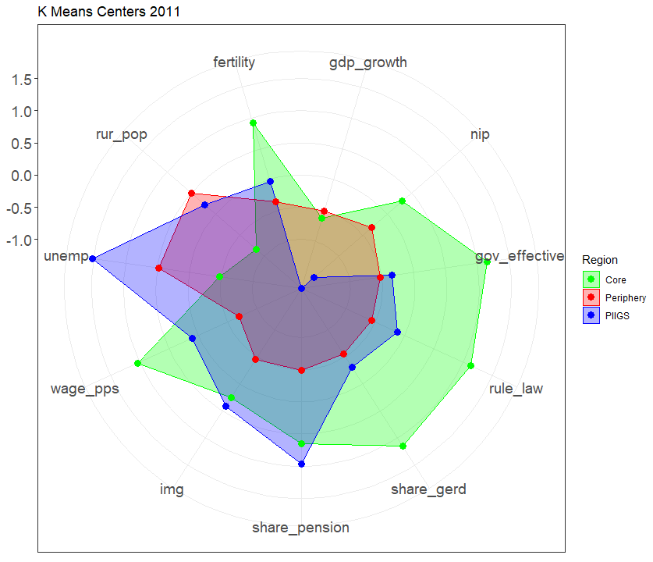
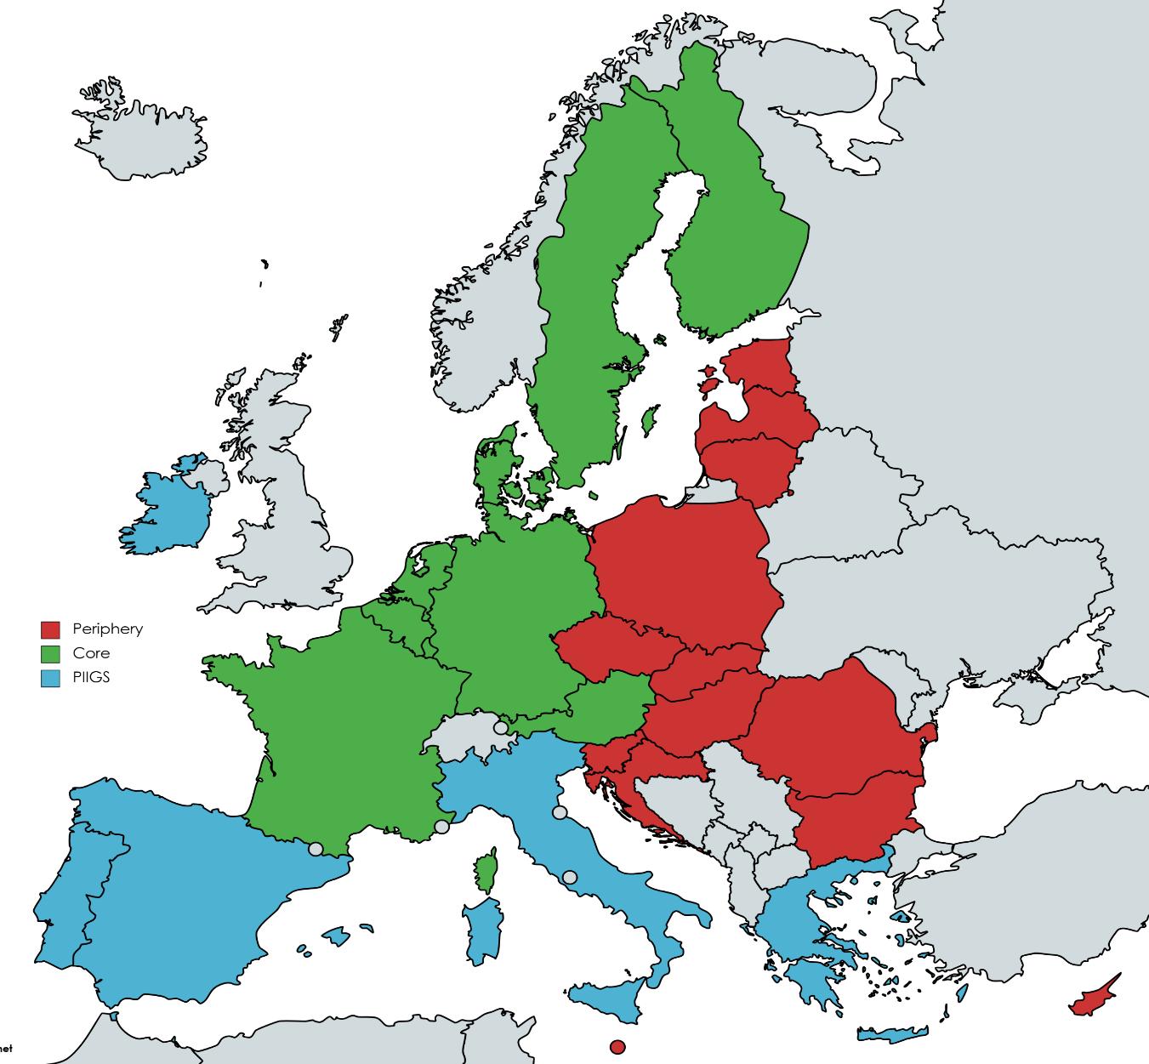
EU Core – Periphery in the 2011

Slide 14
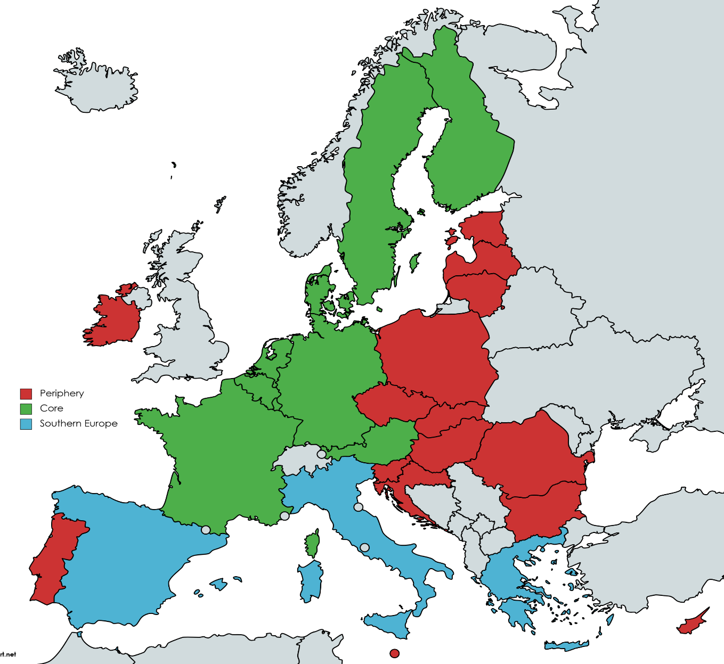
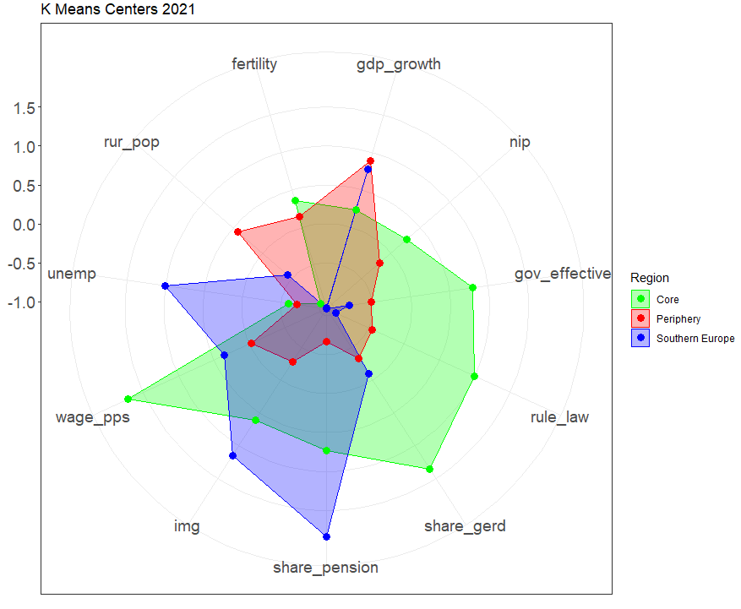
EU Core – Periphery in 2021

Slide 15
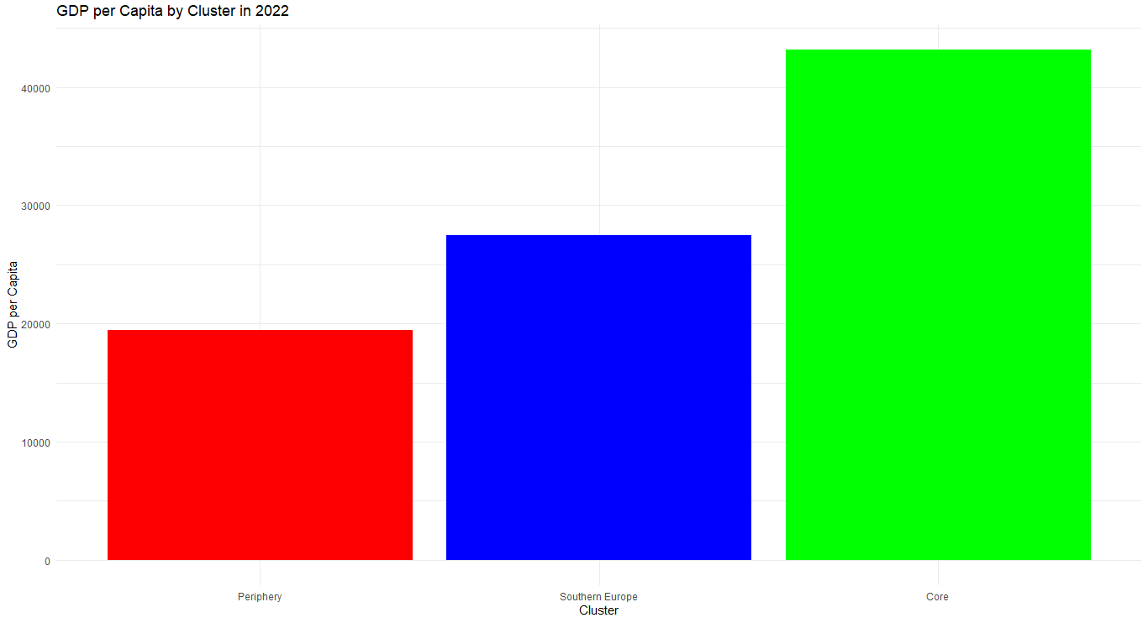
Implication for EU Cohesion
Shifting reality of EU with challenges of ambiguouos members

Slide 16
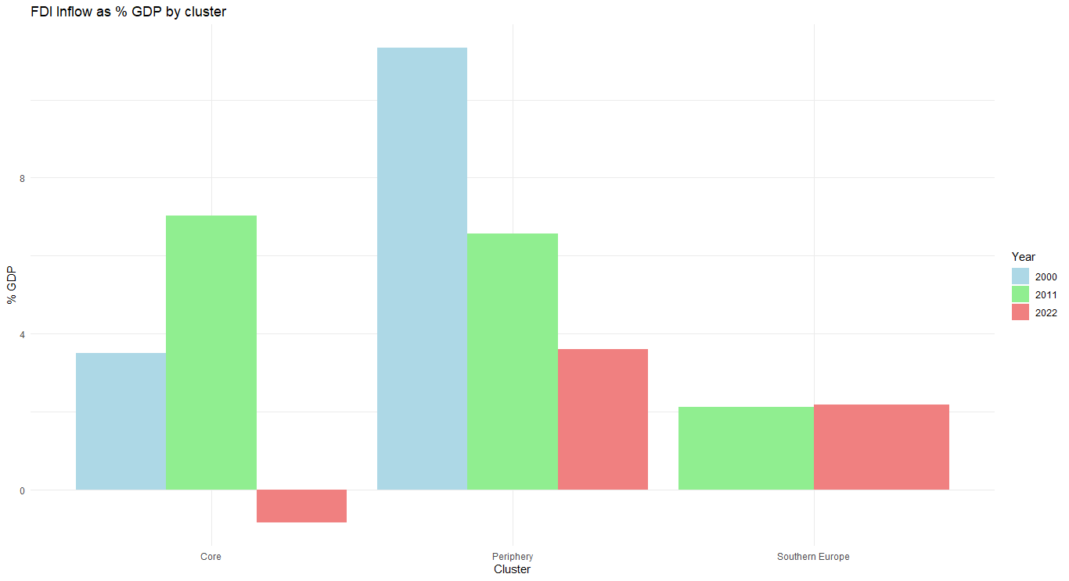
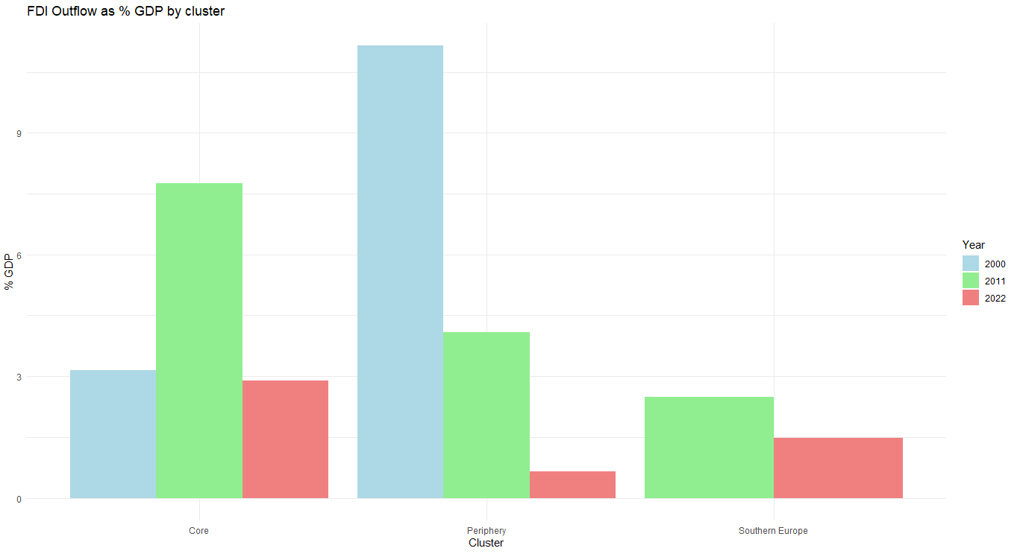
A further step: Deglobalization
Shift in global investment patterns consistent with homeland economics trend

Slide 17
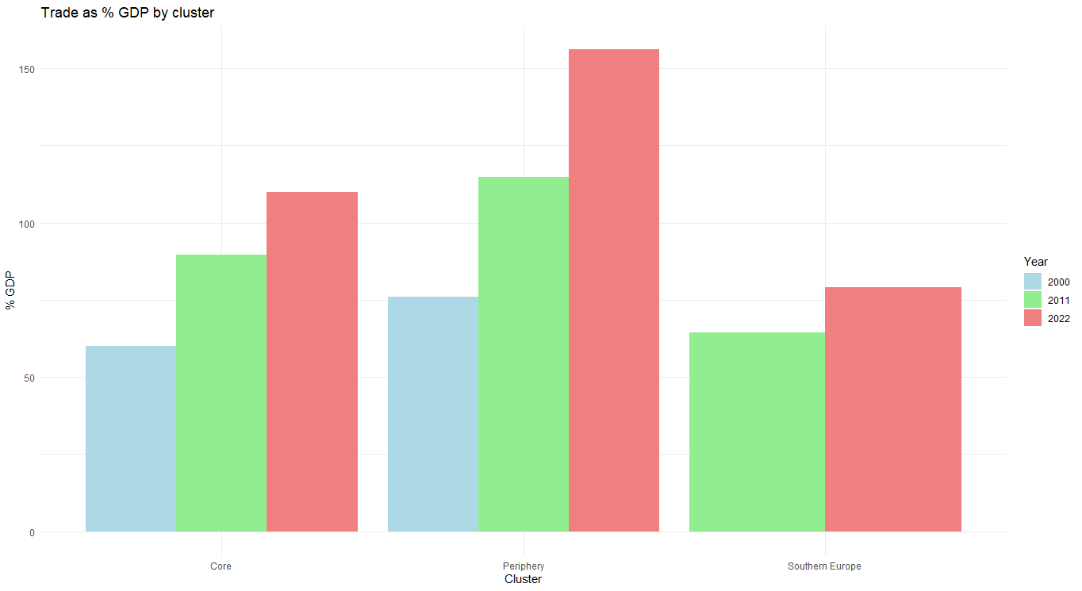
A further step: Deglobalization
no absolute reduction of trade/openness but a more cautious management of it

Slide 18
Conclusion
Growing divergence in the core periphery pattern in EU
Cohesion Policy of EU needs to consider presence of a
Core (North): rich, innovative and effective
2 Peripheries:
Southern Europe with high unemployment, older population, high debt
CEE with rural identity but catching up
Danger of further division
Evidence of Deglobalization still mixed

Slide 19
References
The R code and datasets is accessible on the following GitHub Repository: https://github.com/EliaDG/EU-Core-Periphery-Division-in-the-wake-of-Deglobalization.git
European Commission, Directorate-General for Communication, (2022). The European Union : what it is and what it does, Publications Office of the European Union. https://data.europa.eu/doi/10.2775/5377
Krugman, P. R. (1991) "Increasing Returns and Economic Geography", Journal of Political Economy, 99(3), pp. 483–499. https://doi.org/10.1086/261763
Caraveli, H; Global Imbalances and EU Core-Periphery Division: Institutional Framework and Theoretical Interpretations. World Review of Political Economy , Vol. 7, No. 1 (Spring 2016), pp. 29-55. Available at https://www.jstor.org/stable/10.13169/worlrevipoliecon.7.1.0029
Gräbner, Claudius; Hafele, Jakob (2020) : The emergence of coreperiphery structures in the European Union: A complexity perspective, ZOE Discussion Papers, No. 6, ZOE. Institut für zukunftsfähige Ökonomien, Bonn
Daniel Rauhut & Alois Humer (2020) EU Cohesion Policy and spatial economic growth: trajectories in economic thought, European Planning Studies, 28:11, 2116-2133, DOI: 10.1080/09654313.2019.1709416
Kersan-Škabić, I. (2020) ""Core-Periphery" in the European Union – An Economic Perspective", Periodica Polytechnica Social and Management Sciences, 28(2), pp. 146–154. https://doi.org/10.3311/PPso.13979

Slide 20
Thanks you for the attention!

Slide 21
Appendix
Macro Indicator | Source | Macro Indicator | Source
GDP Growth | WORLD BANK -WDI | FDI inflow as share of GDP | WORLD BANK -WDI
Net Investment Position (%) | EUROSTAT | Trade as share of GDP | WORLD BANK -WDI
Effectiveness of Government | WORLD BANK -WGI | Regulatory Quality | WORLD BANK -WGI
Rule of Law | WORLD BANK -WGI | Voice and Accountability | WORLD BANK -WGI
GERD as share of GDP | EUROSTAT | Corruption Control | WORLD BANK -WGI
Pension as share of GDP | EUROSTAT | Government Gross Debt as share of GDP | EUROSTAT
Total Immigration | EUROSTAT | Political Stability and Absence Violence | WORLD BANK -WGI
Ccompensation of employee per hour worked | EUROSTAT | Total Rural Population | WORLD BANK
Unemployment rate | EUROSTAT | Total GDP | WOLRD BANK/EUROSTAT
Fertility Rate | EUROSTAT | Education Expenditure as share of GDP | WORLD BANK -WDI

Slide 22
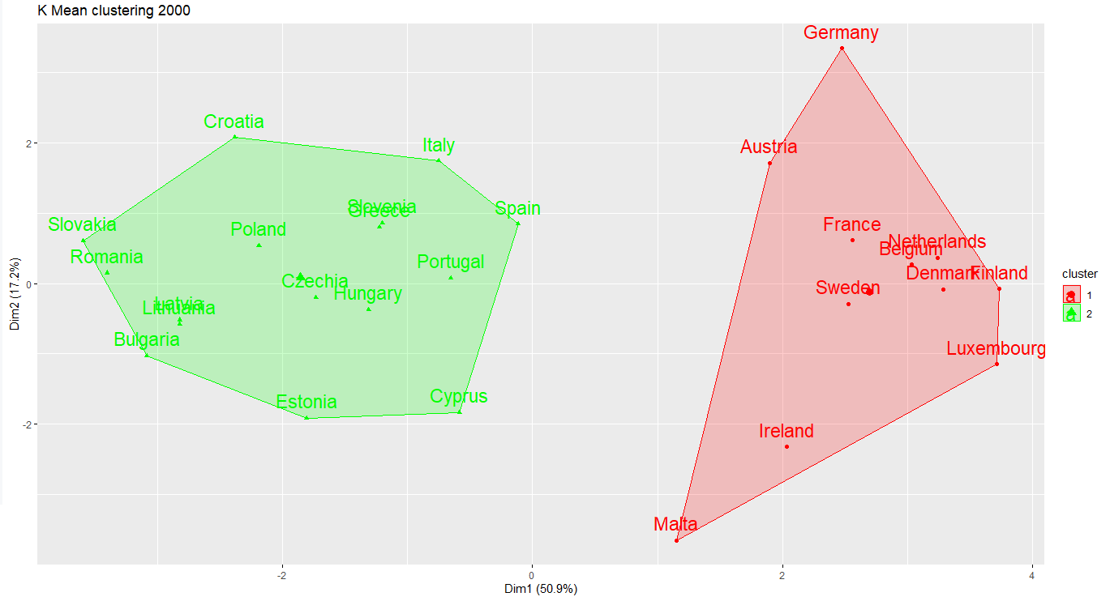
Appendix

Slide 23
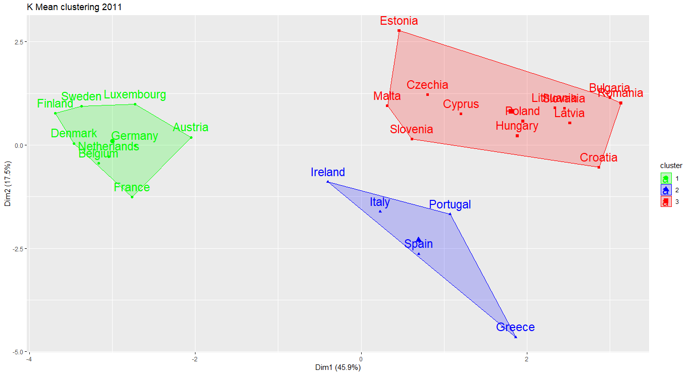
Appendix

Slide 24
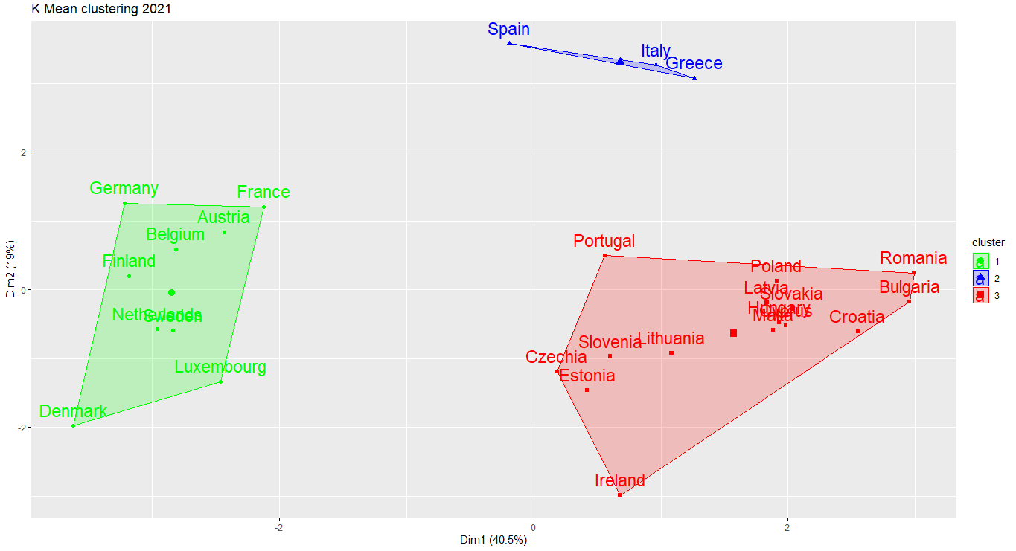
Appendix

